Slide 1
ASSESSMENT
02-04-25
Presented by S. Vinish

Slide 2
What is firewall, What are the types? What's the Main purpose & where it is used in SAP system?

Slide 3
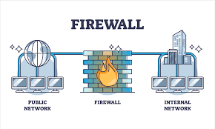
What is Firewall?
Definition – A firewall is a network security device or software that monitors and controls network traffic.
Function – It enforces security rules to regulate incoming and outgoing traffic.
Purpose – It creates a barrier between a trusted internal network and untrusted external networks, like the internet.
Firewalls can be hardware-based, software-based, or a combination of both.

Slide 4
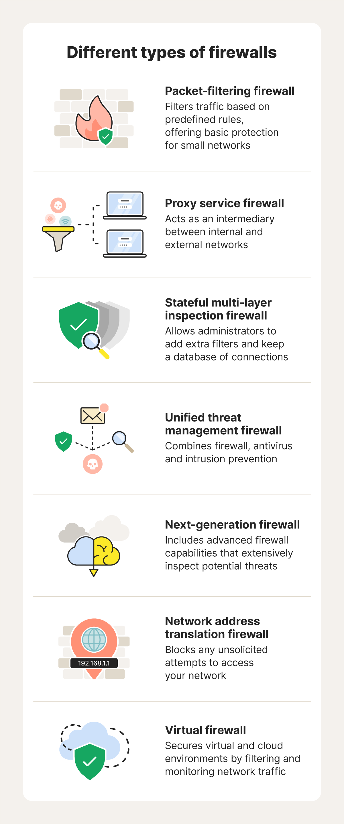
Types of Firewall
Packet-Filtering Firewalls:
✅ Operates at the network layer (Layer 3).
✅ Examines packets based on IP addresses, ports, and protocols.
Stateful Inspection Firewalls:
✅ Works at Layer 3 and Layer 4 (Network & Transport).
✅ Keeps track of active connections and makes filtering decisions based on connection states.
Proxy Firewalls:
✅ Operates at the application layer (Layer 7).
✅ Inspects application data and prevents direct communication between external users and internal systems

Slide 5
Continued…
Next-Generation Firewalls (NGFW):
✅ Combines traditional firewall functions with advanced security features like deep packet inspection (DPI), intrusion prevention, and malware filtering.
Network Firewall
✅ Hardware-based, placed at the boundary of a network.
✅ Protects an entire network rather than a single device.
Cloud-Based Firewall (Firewall-as-a-Service - FWaaS)
✅ Hosted in the cloud by third-party providers
✅ Protects cloud workloads and applications
✅ Scalable and managed remotely
📌 Example: AWS Network Firewall, Azure Firewall

Slide 6
Main purpose of the Firewall
The primary purpose of a firewall is to enhance security by:
Network Security – Prevents unauthorized access to systems.
Traffic Control – Filters incoming and outgoing traffic based on rules.
Threat Prevention – Protects against cyber threats like malware, DDoS attacks, and hacking attempts.
User Authentication – Ensures only authorized users access sensitive data.

Slide 7
Where Firewall is used in SAP?
In an SAP environment, firewalls are used at different layers to secure communication between SAP components and external systems:
Network Segmentation
SAP Application Servers
SAP HANA Database
SAP Cloud Deployments
SAP Router
Between Users and SAP Systems
Between SAP Application Servers and Database Servers
Between SAP Systems in a Distributed Landscape
Between SAP and External Systems
Perimeter Security

Slide 8
Purpose of Firewall in SAP
Data Protection
Safeguards sensitive business data stored in SAP systems.
Access Control
Ensures only authorized users (e.g., employees or partners) can interact with SAP modules.
Compliance
Helps meet regulatory requirements (e.g., GDPR, SOX) by securing data flows.
Threat Mitigation
Blocks attacks targeting SAP vulnerabilities, such as exploits in unpatched systems.

Slide 9
Thank you!

